Slide 1
Term Project
Introduction to Embedded Systems CS410100 2019

Slide 2
Specification
One person to a group.
Use Arduino Uno or MSP430.
Design term project on your own.

Slide 3
Score
1. Basic (40%)
2. Demo & Rank (50%)
3. Report (10%)
4. Bonus (20%)
You can get 120 points at most in the term project.
Plagiarism is not allowed.

Slide 4
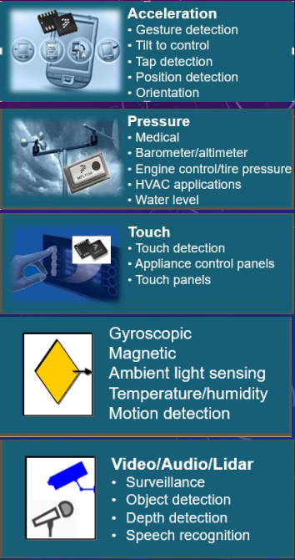
Basic
Timer 5% (time = millis())
DAC 5% (RGB led)
LCD/Actuator(Motor) 10%(Servo motor + LCD)
Sensors 20%(joysticks + infrared)
Choose at least two of them
Need to be useful and related to your goal

Slide 5
Demo & Rank
Completeness will be an important part when demo. You will get penalty if the final work can’t fit your proposal well.
After all groups demo their projects, TAs will rank the groups.
The rank will be then mapped to a grade from 100 to 60 as 50% of your total score.
Note that Top 10 will get into the Final Demo Contest on 1/16

Slide 6
Final Demo Contest on 1/16 for Top 10 Groups
Award price:
第一名：3000元 (共1組)
第二名：2000元 (共1組)
第三名：1000元 (共2組)
佳作：500元 (共6組)

Slide 7
Bonus
Use extra sensors, but the sensors you use must follow the guideline: “The sensor must be helpful and useful in your project, not just for decoration”
If the sensors you use meet the guideline, you can get 5% score.
FreeRTOS (5%)
If you combine MSP430 with Arduino UNO properly, you can get 5~10%. (depending on TAs)

Slide 8
Proposal
1. Project title.
2. Introduction (motivation, functionality, etc.)
3. The components you are going to use.
4. You should upload the proposal to iLMS, revisable before 23:59 p.m. 2019/12/17.
5. TAs may give you feedbacks if they have problems with your proposal.

Slide 9
Report
Report must include
The goal of your project.
What components you use in the term project, explain the detail of your implement in diagram, figure and sentences.
What difficulties did you encounter when implementing this project.
Program flow chart.
If you have any feedbacks, please also write it down.
You should upload the report and project code to iLMS before 23:59 2018/1/18.

Slide 10
Proposal & Report Format
Please name your proposal Proposal_{student-ID}.pdf and upload to iLMS.
Please package your final project code and report in a file named Final_{student-ID}.zip and name your codes/report as follows:
Final_report_{student-ID}.pdf
Final_project_{student-ID}.ino
• E.g. Proposal_106062501.pdf

Slide 11
Schedule
Sun | Mon | Tue | Wed | Thu | Fri | Sat
 |  | 12/10
 |  | 12/17 Proposal deadline
 |  | 12/24
 |  | 12/31
 |  | 1/7
 | 1/13 Demo | 1/14 Demo | 1/15 Demo | 1/16 Final Demo Contest |  | 1/18 Project code & Report deadline

Slide 12
Demo Time
Please fill in your preferred demo time at
https://docs.google.com/spreadsheets/d/1hBziyvJCYT_s5zEv2sk24Qt8ePyc1iPSjv1Yl8Ja0x4/edit#gid=0

